Slide 1


GALE IN CONTEXT: ELEMENTARY
Scientists and Inventors Escape Room

Slide 2
TABLE OF CONTENTS
1 | Cover
2 | Table of Contents
3-4 | Escape Room Instructions and Arrangements
5 | Resource Access
6 | Printing Suggestions for Activities
7 | Answer Sheet
8 | Teacher Answer Key
9-11 | Description Cards for Stations or Folders
12 | Task 1 Directions: Inventors
13 | Task 1 Cut-and-Sort Activity
14 | Task 2 Directions: Elizabeth Blackwell
15 | Task 2 Fill-in-the-Blank Activity
16 | Task 3 Directions: Ada Lovelace
17 | Task 3 Pigpen Cipher Fill-in-the-Blank Activity
18 | Modified Pigpen Cipher
19 | Regular Pigpen Cipher
20 | Task 4 Directions: Sire Isaac Newton
21 | Task 4 Cut-and-Sort Multiple-Choice Question Activity
22 | Task 5 Directions: Katherine Johnson
23 | Task 5 Cut-and-Sort Timeline Activity
24 | Citation Information

Slide 3
GENERAL INSTRUCTIONS
BEFORE
Print and organize all necessary activity materials (see Printing Suggestions). Some stations consist of cut-and-sort activities. You can choose to have students cut these as they progress and then sort or, you can have them cut and placed in envelopes or folders before they begin.
Tasks can be set up as stations or as completion tasks where groups remain in one location. In either setup, it is important to have materials prepared that equal the number of groups. Having a folder/envelope for each task is best practice.
Gale resources should be accessed through the Gale In Context: Elementary database. (See Resource Access page).
DURING
Walk around the room and assist groups when necessary. Each time a group finishes a task, check their code to approve them to go onto the next one.
AFTER
Review reading material with students. This activity works well as an introduction to a topic, or as a culminating activity at the end of a unit. Students can reflect about what they learned during the activity with reflection writing or use what they learned as a starting point for a deeper research project.
TASK-SPECIFIC INSTRUCTIONS
TASK 1:
Instructions: Students will watch the assigned video on Gale In Context: Elementary titled “When Did That Happen? Invention”. As they watch and listen, they will match the inventor to their invention. When in the right order, the letters will be the code they will write on their answer sheet. *Note that the video does speak quicky. There is a transcript below the video for those students who want to read or follow along.
Arrangements: If students are working in groups, have them view the video together or watch individually. See Resource Access for best practices on sharing Gale content with students. The activity for this is a cut-and-sort activity. You can have students cut them and then sort or have them precut and stored in an envelope or bag.

Slide 4
TASK 2:
Instructions: Students will read the assigned Gale In Context: Elementary document, “Elizabeth Blackwell: The First Female Doctor”. They will then answer the fill-in-the-blank questions (Hint: question one has a 2-word answer). They will record their answers on the answer sheet under Task 2. Shaded letters on the answer sheet will reveal their code.
Arrangements: Questions are designed 2-per page to cut down on copies. See Resource Access for best practices on sharing Gale content with students.
TASK 3:
Instructions: Students will read the assigned Gale In Context: Elementary document on Ada Lovelace. They will then use the pigpen cipher tool to crack the code and fill-in-the-blank. They will record the decoded words on their answer sheet under Task 3.
Arrangements: There are 2 copies of the pigpen cipher, a regular and a modified. Choose which one best fits the needs of your students. Make a copy of the cipher for every student so they can work together. See Resource Access for best practices on sharing Gale content with students.
TASK 4:
Instructions: Students will read the Gale In Context: Elementary document “Sir Isaac Newton…detective” and answer the multiple-choice questions. The answers will reveal their code, which they will write on their answer sheet under Task 4.
Arrangements: The multiple-choice questions for this are a cut-and-sort. You can have students cut them and then sort or have them precut and stored in an envelope or bag. See Resource Access for best practices on sharing Gale content with students.
TASK 5:
Instructions: Students will read the Gale In Context: Elementary biography document on Katherine Johnson. They will then put the events in order based on when they happened (chronological). When they are in the correct order, the numbers will be the code the put on their answer sheet under task 5. This is how they finally “escape”!
Arrangements: The events are a cut-and-sort activity. You can have students cut them and then sort or have them precut and stored in an envelope or bag. See Resource Access for best practices on sharing Gale content with students.

Slide 5
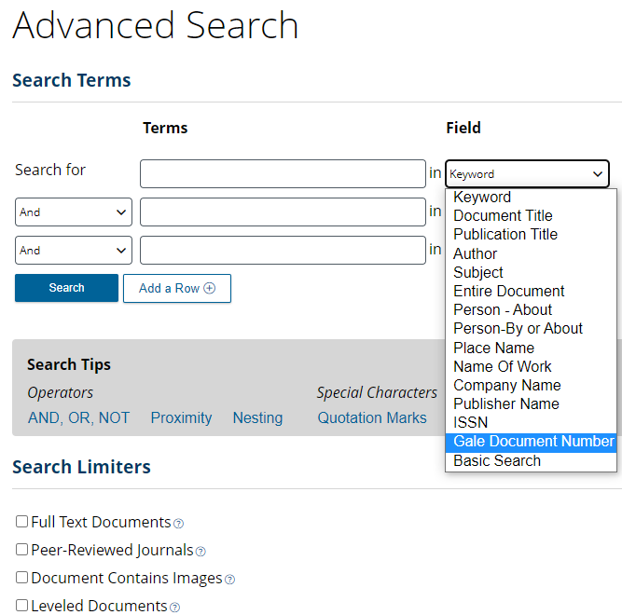
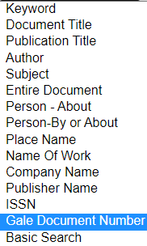

RESOURCE ACCESS
The best way to have students access task articles it to have them visit Gale In Context and perform an Advanced Search.
Provide students with the Gale Document Number.
They will then select Gale Document Number from the Field drop-down menu and enter the document numbers below to access the content for each task.
Task 1: Inventors | YEVCQA258042862
Task 2: Elizabeth Blackwell | A61523858
Task 3: Ada Lovelace | JHGCFN845370830
Task 4: Sir Isaac Newton | A225246468
Task 5: Katherine Johnson | TCMTQW826537308
Articles can also be shared with students via the
Get Link tool.

Slide 6
PRINTING SUGGESTIONS
Page 7 | Answer Sheet
Page 8 | Teacher Answer Key
Page 9-11 | Description Cards for Stations or Folders (optional)
Page 12 | Task 1 Direction Cards (2 per page)
Page 13 | Task 1 Cut-and-Sort Activity
Page 19 | Task 2 Direction Cards (2 per page)
Page 20 | Task 2 Fill-in-the-Blank Activity (2 per page)
Page 21 | Task 3 Direction Cards (2 per page)
Page 22 | Task 3 Pigpen Cipher Fill-in-the-Blank Activity
Page 23 | Modified Pigpen Cipher
Page 24 | Regular Pigpen Cipher (2 per page)
Page 25 | Task 4 Direction Cards (2 per page)
Pages 26-27 | Task 4 Cut-and-Sort Multiple-Choice Activity
Page 28 | Task 5 Direction Cards (2 per page)
Page 30 | Task 5 Cut-and-Sort Timeline Activity
Notes:
Some documents are 2-per page to decrease the number of needed copies. Once cut-and-sort activities are printed and cut out, it is recommended to keep them in an envelope or bag for each group. Consider laminating for future use.
It is recommended that you make 1 copy per student of the cipher (pages 23 or 24).

Slide 7




ANSWER
SHEET
Gale In Context: Elementary
Scientists and Inventors Escape Room
Group Members:
TASK 1
TASK 2
1.
2.
3.
4.
5.
CODE
TASK 3
TASK 4
1. ______________________________
2. __________________
3. ____________________
4. ___________________________
5. ______________________________
TASK 5
_____ _____ _____ _____ _____ _____ _____
YOU ESCAPED!

Slide 8
ANSWER
KEY
Gale In Context: Elementary
Scientists and Inventors Escape Room
Group Members:
TASK 1 | F | C | D | B | A | E
TASK 2
1. | B | U | L | L | S | E | Y | E
2. | T | E | A | C | H | E | R
3. | G | E | N | E | V | A
4. | E | M | I | L | Y
5. | W | O | M | E | N
CODE WORD | B | A | E | M | N
TASK 3
TASK 4
1. computer
2. science
3. machine
4. language
5. countess
C | O | I | N | S
TASK 5
__3__ __4__ __7__ __2__ __6__ __5__ __1__
YOU ESCAPED!

Slide 9
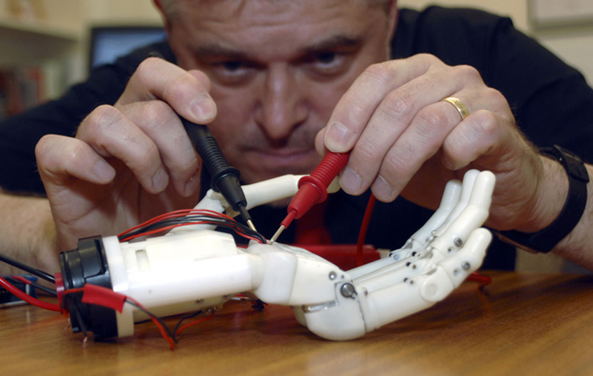
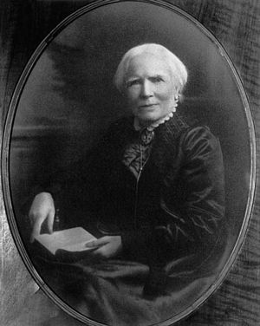
TASK 1
TASK 1
Use the Task 1 resources to complete your task and crack the code! Be sure to record answers on our group answer sheet.
Use the Task 1 resources to complete your task and crack the code! Be sure to record answers on our group answer sheet.
INVENTORS
INVENTORS
TASK 2
TASK 2
Use the Task 2 resources to complete your task and crack the code! Be sure to record answers on our group answer sheet.
Use the Task 2 resources to complete your task and crack the code! Be sure to record answers on our group answer sheet.
ELIZABETH BLACKWELL
ELIZABETH
BLACKWELL
Notes:
These task cards can be printed and placed on the folder or envelope you use for each task. For example, print task cards equal to the number of class groups. Attach the task cards to folders, which inside would have the activities and necessary supplies for each task.

Slide 10
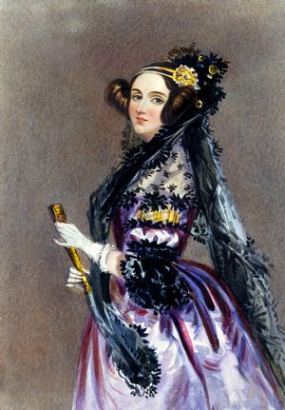
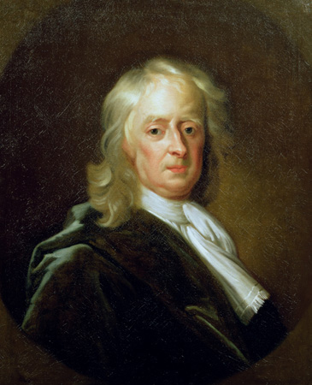
TASK 3
TASK 3
Use the Task 3 resources to complete your task and crack the code! Be sure to record answers on our group answer sheet.
Use the Task 3 resources to complete your task and crack the code! Be sure to record answers on our group answer sheet.
ADA
LOVELACE
ADA
LOVELACE
TASK 4
TASK 4
Use the Task 4 resources to complete your task and crack the code! Be sure to record answers on our group answer sheet.
Use the Task 4 resources to complete your task and crack the code! Be sure to record answers on our group answer sheet.
SIR ISAAC NEWTON
SIR ISAAC
NEWTON
Notes:
These task cards can be printed and placed on the folder or envelope you use for each task. For example, print task cards equal to the number of class groups. Attach the task cards to folders, which inside would have the activities and necessary supplies for each task.

Slide 11
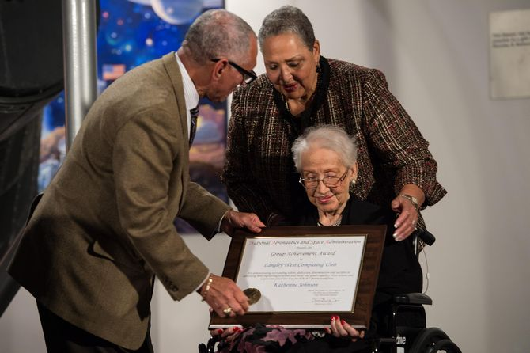
TASK 5
TASK 5
Use the Task 5 resources to complete your task and crack the code! Be sure to record answers on our group answer sheet.
Use the Task 5 resources to complete your task and crack the code! Be sure to record answers on our group answer sheet.
KATHERINE
JOHNSON
KATHERINE
JOHNSON
Notes:
These task cards can be printed and placed on the folder or envelope you use for each task. For example, print task cards equal to the number of class groups. Attach the task cards to folders, which inside would have the activities and necessary supplies for each task.

Slide 12
TASK 1
WHEN DID THAT HAPPEN? INVENTION
Inventors create new products. The telephone, the electric guitar, and lasers are all examples of successful inventions.
Inventors claim legal ownership of their invention by getting a patent. Patents are a form of legal protection. They are issued by the government.
Inventors can make and sell their patented inventions. Some inventions are very successful. But many others do not make money.
There will always be inventors. There are always better ways to do things. Inventors create these things.
Directions: Watch the assigned video on Gale In Context: Elementary titled “When Did That Happen? Invention”. As you watch and listen, match the inventor to their invention. When in the right order, the letters will be your code. Put the code on your answer sheet.
- - - - - - - - - - - - - - - - - - - - - - - - - - - - - - - - - - - - - - - - - - - - - - - - - - - - - - -
TASK 1
WHEN DID THAT HAPPEN? INVENTION
Inventors create new products. The telephone, the electric guitar, and lasers are all examples of successful inventions.
Inventors claim legal ownership of their invention by getting a patent. Patents are a form of legal protection. They are issued by the government.
Inventors can make and sell their patented inventions. Some inventions are very successful. But many others do not make money.
There will always be inventors. There are always better ways to do things. Inventors create these things.
Directions: Watch the assigned video on Gale In Context: Elementary called “When Did That Happen? Invention”. As you watch and listen, match the inventor to their invention. When in the right order, the letters will be your code. Put the code on your answer sheet.

Slide 13
1
Marion Donovan
F
disposable diaper
2
Mary
Anderson
A
dishwasher
3
Lonnie
Johnson
B
cell phone
4
Martin Cooper
E
zipper
5
Josephine Cochrane
D
water gun
6
Whitcomb L. Judson
C
windshield wipers
Notes:
Students will match the correct answer to its corresponding question. Once in numerical order, the code will be revealed. Students will record this code on their answer sheet.

Slide 14
TASK 2
ELIZABETH BLACKWELL
Elizabeth Blackwell was the first female doctor in America. She was born in 1821.
Most women stayed at home then. They did not have jobs. They did not go to college.
Blackwell was different. She became a doctor.
She also opened a school. It was for women. These women wanted to be doctors.
Directions: Read the assigned Gale document, “Elizabeth Blackwell: The First Female Doctor”. Answer the fill-in-the-blank questions (Hint: question one has a 2-word answer). Use the shaded letters on your answer sheet for your code.
- - - - - - - - - - - - - - - - - - - - - - - - - - - - - - - - - - - - - - - - - - - - - - - - - - - - - - -
TASK 2
ELIZABETH BLACKWELL
Elizabeth Blackwell was the first female doctor in America. She was born in 1821.
Most women stayed at home then. They did not have jobs. They did not go to college.
Blackwell was different. She became a doctor.
She also opened a school. It was for women. These women wanted to be doctors.
Directions: Read the assigned Gale document, “Elizabeth Blackwell: The First Female Doctor”. Answer the fill-in-the-blank questions (Hint: question one has a 2-word answer). Use the shaded letters on your answer sheet for your code.

Slide 15
Elizabeth’s teacher brought in a ______ ______ to teach how the human eye worked.
Elizabeth worked as a _____________ in North Carolina and South Carolina to save her money.
After being denied to several medical schools, she was accepted at a small school in ______________, New York, where she graduated top of her class.
Elizabeth’s sister, ___________ , came to work at her dispensary in New York after graduating medical school in Ohio.
After opening and running a successful hospital, the sisters opened their own medical school for ________________.
- - - - - - - - - - - - - - - - - - - - - - - - - - - - - - - - - - - - - - - - - - - - - - - - - - - - - - -
Elizabeth’s teacher brought in a ______ ______ to teach how the human eye worked.
Elizabeth worked as a _____________ in North Carolina and South Carolina to save her money.
After being denied to several medical schools, she was accepted at a small school in ______________, New York, where she graduated top of her class.
Elizabeth’s sister, ___________ , came to work at her dispensary in New York after graduating medical school in Ohio.
After opening and running a successful hospital, the sisters even opened their own medical school for ________________.
Notes:
Students will record their one-word answers into the Task 2 section of their answer key. Note that question 1 has a 2-word answer.
The shaded boxes will reveal their code, which they will record below.

Slide 16
TASK 3
ADA LOVELACE
Ada Lovelace liked math. She was good it. She was from England.
She may have been a computer programmer. She may have been the first,
She had many ideas. They were about computers.
Lovelace was born in 1815. Her father wrote poems. He was famous.
She never knew him, though. He left after she was born.
Directions: Use the pigpen cipher tool to crack the code and fill-in-the-blank. Record the decoded words on your answer sheet under Task 3.
- - - - - - - - - - - - - - - - - - - - - - - - - - - - - - - - - - - - - - - - - - - - - - - - - - - - - - -
- - - - - - - - - - - - - - - - - - - - - - - - - - - - - - - - - - - - - - - - - - - - - - - - - - - - - - -
TASK 3
ADA LOVELACE
Ada Lovelace liked math. She was good it. She was from England.
She may have been a computer programmer. She may have been the first,
She had many ideas. They were about computers.
Lovelace was born in 1815. Her father wrote poems. He was famous.
She never knew him, though. He left after she was born.
Directions: Use the pigpen cipher tool to crack the code and fill-in-the-blank. Record the decoded words on your answer sheet under Task 3.

Slide 17















1. Lovelace is thought of as the first ___________________ programmer.
2. Lovelace began studying math and _____________ at the age of four.
3. Lovelace translated an article discussing Charles Babbage’s invention. She added her own notes, which described a way for the _______________ to follow a set of instructions that would repeat in a loop. Many consider this the first computer program.
4. Few people realized how important Lovelace’s ideas were when she was alive. Her ideas were discovered about 100 years after her death. Lovelace has been honored for her work in modern times. A whole computer _______________ was named “Ada” in her honor in 1980.
5. Lovelace married William King in 1835. In 1838 King became the Earl of Lovelace. Lovelace became known as the __________________of Lovelace.
Notes:
Students will record their deciphered words on their answer sheets under task 3.

Slide 18











PIGPEN CIPHER
A | B | C | D | E | F
G | H | I | J | K | L
M | N | O | P | Q | R
S | T | U | V | W | X
Y | Z
Notes:
Modified cipher

Slide 19
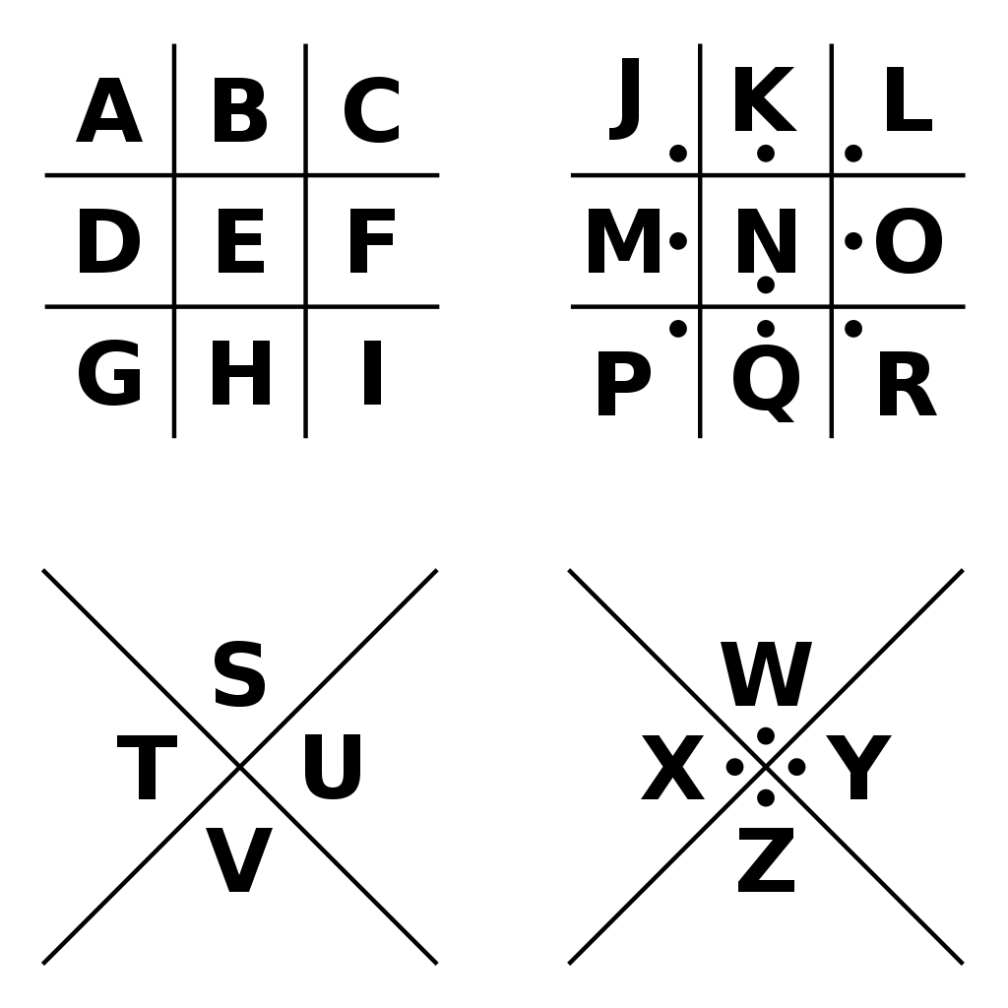
PIGPEN CIPHER
- - - - - - - - - - - - - - - - - - - - - - - - - - - - - - - - - - - - - - - - - - - - - - - - - - - - - - -
PIGPEN CIPHER
Notes:
Regular cipher

Slide 20
TASK 4
SIR ISAAC NEWTON
Isaac Newton was an English scientist and professor. He is one of the greatest scientists of all time.
Isaac Newton was born on January 4, 1643, in Woolsthorpe, England. His father was also named Isaac. He died three months before Newton was born.
Isaac Newton discovered the laws of motion.
Directions: Read the Gale document “Sir Isaac Newton…detective” and answer the multiple-choice questions. The answers will reveal your code. Write your code on your answer sheet.
- - - - - - - - - - - - - - - - - - - - - - - - - - - - - - - - - - - - - - - - - - - - - - - - - - - - - - -
TASK 4
SIR ISAAC NEWTON
Isaac Newton was an English scientist and professor. He is one of the greatest scientists of all time.
Isaac Newton was born on January 4, 1643, in Woolsthorpe, England. His father was also named Isaac. He died three months before Newton was born.
Isaac Newton discovered the laws of motion.
Directions: Read the Gale document “Sir Isaac Newton…detective” and answer the multiple-choice questions. The answers will reveal your code. Write your code on your answer sheet.

Slide 21
1. Isaac Newton investigated crime and criminals, but only when they involved what?
a. stolen credit cards c. counterfeit money
b. smuggled goods d. stolen cars
2. In 1696, 1 out of every ______ coins was counterfeit or fake.
l. 100 n. 50
m. 20 o. 10
3. British counterfeiters were known as what?
h. masters j. minters
i. coiners k. clippers
4. Early in 1696, the British government decided to withdraw all handmade coins from circulation and replace them with new, machine-made ones. This was known as the what?
n. Great Recoinage p. Fake Gate
o. Counterfeit Clip q. Newton’s Net
5. One of Newton’s many secrets was that he practiced what?
r. magic t. clipping
s. alchemy u. stealing
Notes:
For this task, students will answer the 5 multiple choice questions. Once answered and the questions are placed in numerical order, the answers will serve as the code that students will record on their answer sheets. This will spell out the word COINS.

Slide 22
TASK 5
KATHERINE JOHNSON
Katherine Johnson worked with numbers. She worked for NASA. She helped people travel into space.
Johnson was born in 1918. She grew up in West Virginia.
Johnson was smart. She was good at math. She finished middle school early. She was only 10.
She could not go to high school.
Directions: Read the Gale biography document on Katherine Johnson. Put the events in order based on when they happened. When they are in the right order, use the numbers as your code on your answer sheet. This is how you finally escape!
- - - - - - - - - - - - - - - - - - - - - - - - - - - - - - - - - - - - - - - - - - - - - - - - - - - - - - -
TASK 5
KATHERINE JOHNSON
Katherine Johnson worked with numbers. She worked for NASA. She helped people travel into space.
Johnson was born in 1918. She grew up in West Virginia.
Johnson was smart. She was good at math. She finished middle school early. She was only 10.
She could not go to high school.
Directions: Read the Gale biography document on Katherine Johnson. Put the events in order based on when they happened. When they are in the right order, use the numbers as your code on your answer sheet. This is how you finally escape!

Slide 23
3
Johnson grew up in White Sulphur Springs, West Virginia. She was a very good student. She had a special talent for math. She finished middle school when she was only ten years old.
5
A movie called Hidden Figures focuses on the lives of three African American human computers. One of these is Katherine Johnson. The other women honored in the film were Mary Jackson and Dorothy Vaughan.
1
Katherine Johnson turned 100 years old.
4
She married James Francis Goble, and they had three daughters together.
7
NASA succeeded in putting the first person, Alan Shepard, into space
2
Johnson retired from her job at NASA.
6
Katherine was awarded the Presidential Medal of Freedom.
Notes:
For this task, students will arrange the 7 different events in chronological order. Once in the correct order, the numbers in the black boxes will reveal the code that students will record on their answer sheet.

Slide 24
CITATION INFORMATION
TASK 1
"Inventors." Careers, Gale, 2014. Gale Elementary Online Collection. Gale In Context:Elementary, link.gale.com/apps/doc/MELTXB926039047/ITKE?u=[ LOCATIONID]&sid=bookmark-ITKE&xid=60aa84d9. Accessed 22 Nov. 2022.
"When Did That Happen? Invention." When Did That Happen? Invention, 1 Jan. 2017. GaleInContext:Elementary, link.gale.com/apps/doc/YEVCQA2580428 62/ITKE?u=[LOCATIONID]&sid=bookmark-ITKE&xid=30fcbae8. Accessed 22 Nov. 2022.
TASK 2
"Elizabeth Blackwell." Gale Elementary Online Collection, Gale, part of Cengage Group, 2020. GaleInContext:Elementary, link.gale.com/apps/doc/ZZOJGN887306030/ITK E?u=[LOCATIONID]&sid=bookmark-ITKE&xid=af18b575. Accessed 28 Nov. 2022.
"Elizabeth Blackwell: The First Woman Doctor." Child Life, vol. 79, no. 3, Apr. 2000, p.
24. GaleInContext:Elementary, link.gale.com/apps/doc/A61523858/ITKE?u=[LOCA TIONID]&sid=bookmark-ITKE&xid=f9e03b99. Accessed 28 Nov. 2022.
TASK 3
"Ada Lovelace." Gale Elementary Online Collection, Gale, part of Cengage Group, 2020. GaleInContext:Elementary, link.gale.com/apps/doc/JHGCFN845370830/ITKE ?u=[LOCATIONID]&sid=bookmark-ITKE&xid=238f912f. Accessed 28 Nov. 2022.
TASK 4
"Isaac Newton." Gale Elementary Online Collection, Gale, part of Cengage Group,
2022. GaleInContext:Elementary, link.gale.com/apps/doc/KRWJBS309846111/ITKE ?u=[LOCATIONID]&sid=bookmark-ITKE&xid=7232c7b2. Accessed 28 Nov. 2022.
Rosinsky, Natalie M. "Sir Isaac Newton ... detective." Odyssey, vol. 19, no. 2, Feb. 2010, pp.32+. GaleInContext:Elementary, link.gale.com/apps/doc/A225246468/ITKE?u= [LOCATIONID]&sid=bookmark-ITKE&xid=fc42636f. Accessed 28 Nov. 2022.
TASK 5
"Katherine Johnson." Gale Elementary Online Collection, Gale, part of Cengage Group, 2020. GaleInContext:Elementary, link.gale.com/apps/doc/SYVJCZ527312775/ITKE? u=[LOCATIONID]&sid=bookmark-ITKE&xid=d3c77398. Accessed 28 Nov. 2022.
"Katherine Johnson." Gale Elementary Online Collection, Gale, part of Cengage Group, 2020. GaleInContext:Elementary, link.gale.com/apps/doc/TCMTQW826537308/IT KE?u=[LOCATIONID]&sid=bookmark-ITKE&xid=a6bea3a0. Accessed 28 Nov. 2022.
EXPLORE MORE!
Find more classroom resources and support materials at:
support.gale.com
Notes:
Citation information for each of the task document.

